Slide 1
Scientific Calculator
FINAL PROJECT

Slide 2
Project (Scientific Calculator) with GUI Based. It was made by using simple NOTEPAD.
NAME: Adeel Ahmed Qureshi.
CMS : 023-22-0141
Class : BsCs(II)- D
Teacher: Sir Faheem Akhtar Rajput
Course : Object Oriented Programming(JAVA)
Date : 14/06/2023

Slide 3
The purpose of this project (Scientific Calculator):
The purpose of this project to solve complicated mathematical questions which are not solved by using simple calculator.
Which OOP’s concepts are used in this project:
The major components of OOP such as Polymorphism, Encapsulation, Inheritance, Abstraction( Interfaces ), Math library, bacis concepts of programing, logic creativity, and GUI packages, Event Handling , such as Javax.*, awt.*, awt.event.* .Furthermore, Exception Handling, User defined Packages, Designs with pictures.
Why this calculator is better than other calculator:
This project has more range of digits(1.7E-308 to 1.7E+308) more than other calculators. And more functionality with different disigns.
It has the trigonometric functionality.
It has nth power and nth root functionality-which is not commonly in others. Not only this but, also factorial of any number and many more.

Slide 4
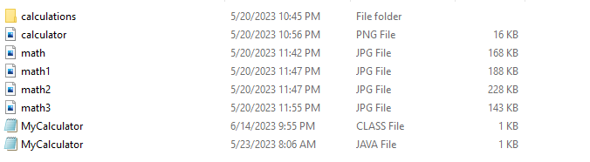
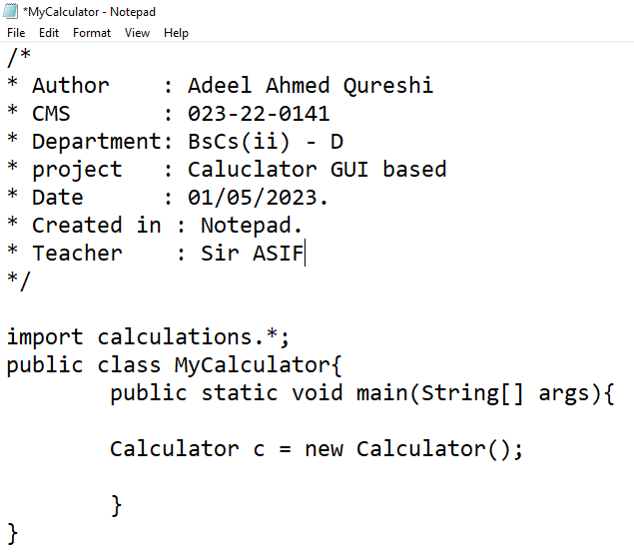
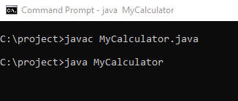
The main gate of program:
The main class of my project is
“ MyCalculator ”.
It has imported user defined packaged which is “ calculations ”.
This Package has different class which are closely related to each other.

Slide 5
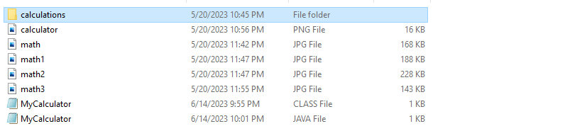
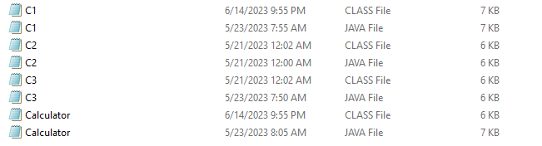
User Defined Package:
MY Package name is: “ calculations ”
It has these classes which are shown in the second Picture.
Inside calculation package>>

Slide 6
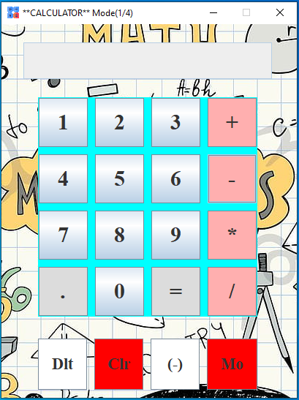
Project first Interface:
This is the Mode one ( 1/4 ).
It has fix size. We cannot maximize or minimize.
It has all basic operations With
*Delete button ( Dlt )
*Clear Button ( Clr )
*Minus Sign button to add minus sign to the button ( - ). IF you want to add negative sign to the number then First select number than press ( - ) this button.
*Mode button which display other operations with new frame design.

Slide 7
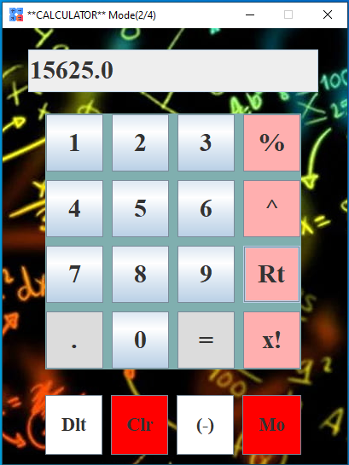
The Second Mode:
*It is the second mode ( 2/4 )
*It has Percentage method that find the percentage of any number: suppose 30 % of 45000. here num1 =30 num2 = 45000.
*It has nth power function; first number is base and second number we select power to this base.
Ex: 8 ^ 5
*It has nth root function ( Rt )
First number is the redicand and second number is root number
i.e., 64 to the root 2 or 3 or 5.5 or 4.44443
Any root of any number we can find easily.

Slide 8
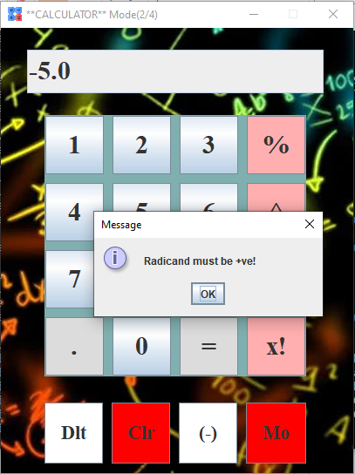
Exception handling:
*Here we trying to find ROOT ( Rt ) of negative number, but the radicand never be negative so, its display message.

Slide 9
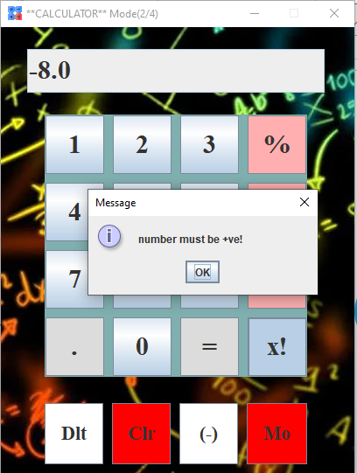
Exception Handling:
Similarly, Any negative number has no any FACTORIAL.
As we try to find Factorial ( X! ) the message is shown that “number must be positive +ve!”

Slide 10
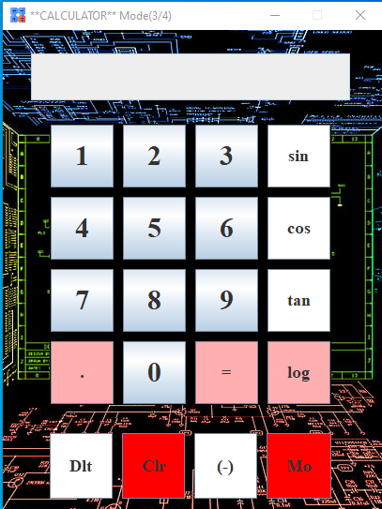
Third Mode of Calculator (3/4):
This is the Third feature of our calculator in which we perform trigonometric problems.
It has also a simple log function that gives us the log value of any number of its domain.

Slide 11
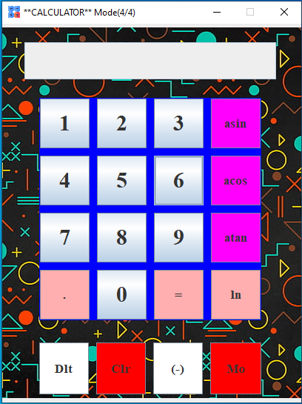
Fourth & last Mode ( 4/4):
* This is the fourth and last feature of our program in which we find inverse trigonometric functions.
It has also the feature of natural logarithm.
And If We again press the mode button then we move to mode1 and similarly mode2 , mode3 and more4 then again mode1 continuously; means this mode function works as chain. Until we close the program.

